Slide 1
Access to Capital for Ag Producers
Jess Sarsfield–AgVision
Notes:
Introduction, overview company and our products/services

Slide 2
Notes:
To improve the lives of our customers and employees, the communities where we work and raise our families, and the Northwest food and fiber industries that perform a vital role in the United States and around the world.
We’ve been providing credit and related services to agriculture for 100 years. Cooperative structure (member owners)

Slide 3
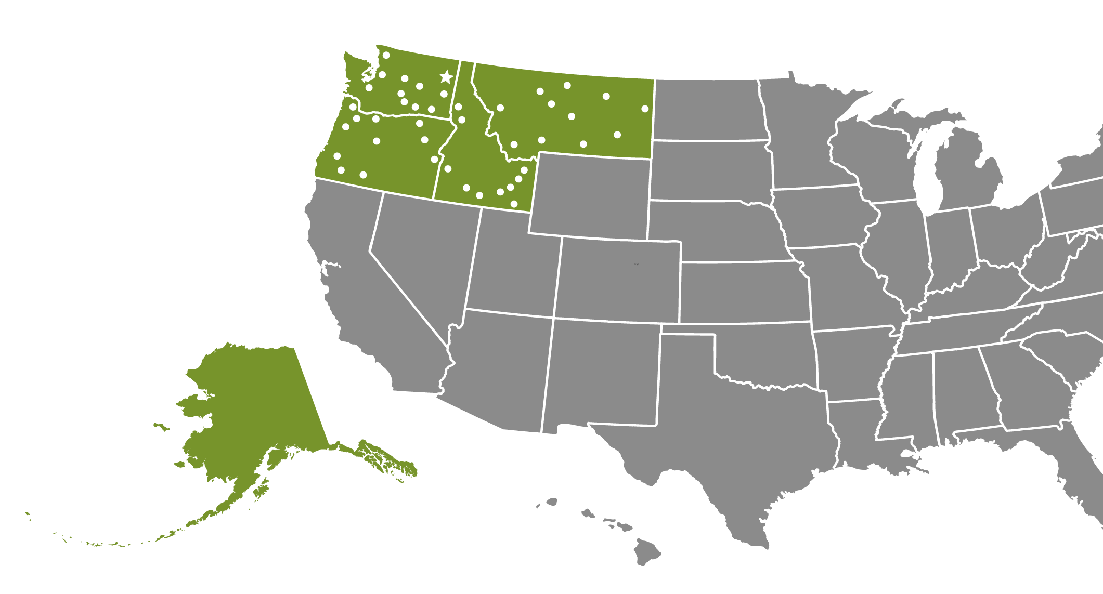
16,921 Customer Members
45 Branch Locations
739 Employees
14 Directors
190 Local Advisors
Notes:
Our financial cooperative is owned by customer-members who have a unique say in the governance of our company by electing board members with agricultural and related backgrounds to represent them.
We also have more than 180 local advisors who are customers-members. They provide feedback from our customers and help share the Farm Credit story.

Slide 4
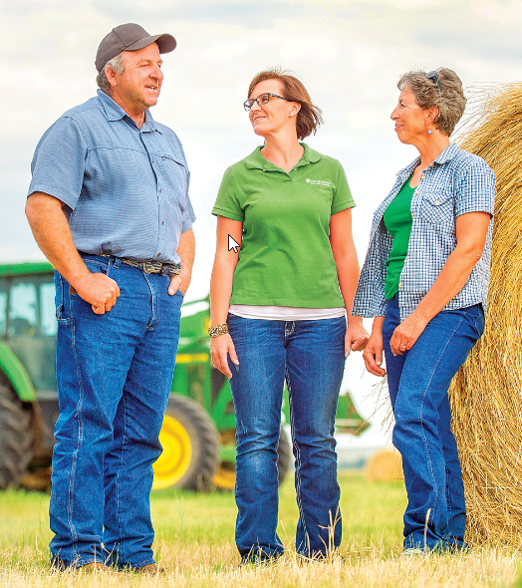
Farmers and Ranchers
Cooperatives
Commercial Fishermen
Forest products producers
Rural home owners
Crop Insurance
4
4
Notes:
Our customers are farmers, ranchers, commercial fishermen, forest products producers, rural home owners and cooperatives.
We serve both ends of the spectrum – from young, beginning producers to large, multi-family agribusinesses -- and everyone in between.

Slide 5
Waived fees
Reduced interest rates
Financial mentors
Management seminars
Education and technology vouchers
RateWise and JumpStart program
5
5
5
5
5
Notes:
All of us in agriculture share a responsibility to launch the next generation of promising young producers. Our AgVision program is designed to help these producers, especially those who may have difficulty finding financing elsewhere. Through the AgVision program we also offer unique benefits including loan fee reductions, preferred rates and flexible terms.
We work closely with young, beginning producers to help them understand their finances and business opportunities. We also offer financial and management workshops to help them grow.

Slide 6
AgVision Eligibility Criteria
Young (35 years of age or younger)
Beginning – 10 years of farm management experience or less
Small – annual gross farm income less than $350,000
Notes:
USDA FSA “YBS” - $250k annual gross farm income
NWFCS and FSA - Beginning farmer – less than 10 years farm management experience
Part-time farmers qualify

Slide 7
AgVision Program Guidelines
Cash flow budget projecting repayment capacity
Minimum 650 credit score
Business plan
No debt concession from any lender within last seven years
Adequate collateral for the loan
Notes:
Off-farm income

Slide 8
RateWise Program
Rewards young, beginning and small producers for continuing management education with interest rate reductions on new loans
Participants can earn interest rate reductions of 0.25%, 0.50% and 0.75% for three years
Credits earned for Northwest FCS workshops, university conferences, industry specific workshops, etc.
Register at northwestfcs.com/RateWise
Notes:
10 credits: 0.25 percent interest rate reduction for three years
20 credits: 0.50 percent interest rate reduction for three years
30 credits: 0.75 percent interest rate reduction for three years
NWFCS 1+ days = 6 credits
University or Industry program = 1+ days = 3 credits
Webinars – 1 credit regardless of duration (5 max)

Slide 9
AgVision Partners
Farm Service Agency (FSA)
FSA guarantee: 90-95%
FSA Down Payment Program – Joint Financing (5-45-50)
Washington State Beginning Farmer Bond Program
Borrow up to $524,200
Payment Assistance Loan (PAL) program – helps with down-payment
Some limitations apply (non-farm residence)

Slide 10
JumpStart – an AgVision Product
Start up capital to help beginning and undercapitalized producers get started in agriculture
Interest-only, 5-year loan
Capital purchases (land, equipment, quota, livestock)
Improvements
Down payment assistance
Notes:
Down payment for a non NWFCS loan an option – AgDirect, FSA
Can also be made to beginning co-ops that require start-up capital to enable a group of entrepreneurs to organize their businesses as a cooperative.
Not for operating lines or consumer purchases

Slide 11
JumpStart Eligibility
Meet YBS criteria (young, beginning, small producer)
One year of relevant experience
Business plan including monthly cash flow budget
Secured by appropriate assets
Annual farm visit
Notes:
Additionally, current balance sheet, verifications of assets and liabilities, inventory and equipment list, monthly cash flow budget, two years tax returns, annual farm visit.
Capital expenditure covenant
Subordinate in payment priority to any other NWFCS loan
Secured by appropriate assets - depending on loan purpose
Accrued interest payment frequency aligns with repayment source, paid annually at minimum
Principal payments strongly encouraged
Fully-pre-payable, 5-year fixed to maturity

Slide 12
The Business Management Center
Management education
Economic updates
Industry insights
Family business resources
12
12
12
12
12
Notes:
Helping customers learn and grow is the foundation of our success. That’s why we continue to invest in our Business Management Center. Educational programs, industry insights and business tools help our customers enhance their financial and management skills. These programs also help customers transition leadership and management of their businesses to the next generation.

Slide 13
Business Management Center
Business Tools: Risk Management Planning and Financial Statements
eLearning modules: Cash Flow Budget and Balance Sheet
Weather Insights (Eric Snodgrass – weekly updates)
Recent webinar recordings
Dairy Market outlook
Virtual Summit series
Sign up at northwestfcs.com/subscribe or access online eLearning modules on demand

Slide 14
Our Stewardship Mission
Rural Community Grants
Food Banks
Scholarships
Military Veteran Support
Youth Education
14
14
14
14
14
Notes:
2020 Rural Community Grant changes – Application is on our website.
Focus is on supporting rural communities during the COVID-19 pandemic. To better assist with disaster relief, we are significantly increasing the amount of funds available in the 2020 Rural Community Grant program, and we are narrowing our focus to support non-profit organizations that are meeting the essential needs of rural communities.
Essential non-profit organizations throughout Washington, Oregon, Idaho, Montana and Alaska are all encouraged to apply. Eligible organizations include food pantries, food distribution/transport services, children’s food programs, senior centers, nursing homes, medical centers, mental health clinics, health districts, volunteer fire and medical services, ambulance services, etc.

Slide 15
Notes:
Contact info:
Jesika Harper, VP-AgVision
Jesika.harper@northwestfcs.com

